Slide 1
User Manual
Smart Systems for Occupancy and Building Energy Control
Team: Dalaidis Hidalgo, Maria E. Presa Reyes Mentor: Ali Mostafavi, Leonardo Bobadilla

Slide 2
Overview
You can use the application Smart System for Occupancy and Building Energy Control in order in to conduct how to use the energy in the appropriate manner.
This manual delivers an overview of the sample application. Beginning with the following information:
Login
Create Account
Add a Zone
Select a Zone
Reward
Zones Description
Temperature
Occupancy
Plug Load
Lighting
Prediction of Air Conditioning
Animation Gifs
Prediction of Consumption of appliances
Logout

Slide 3
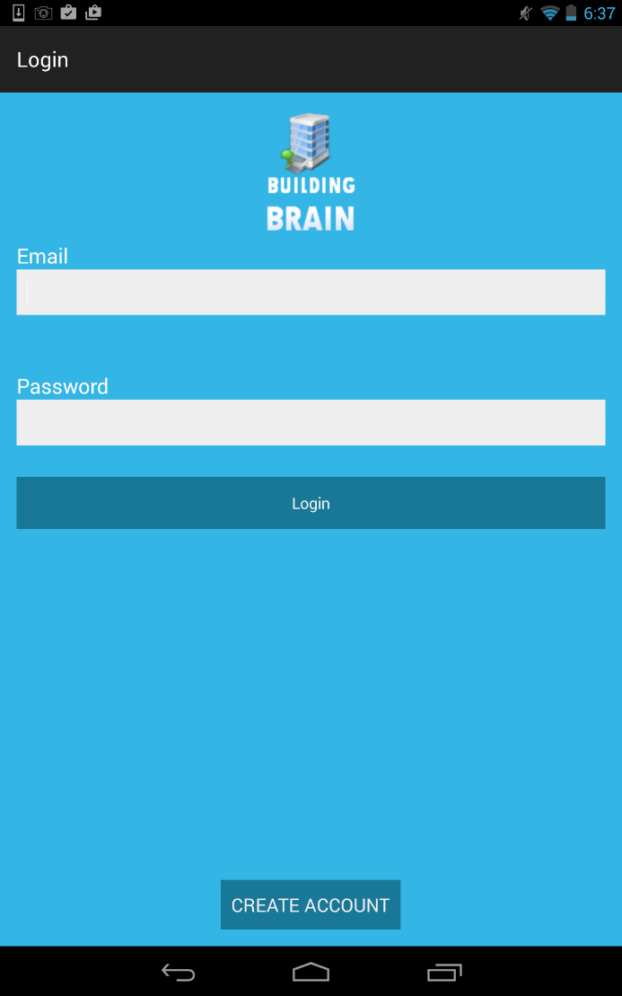
Step 1
The user is required to enter the username and password and make a click on the LOGIN button.
First the user need to CREATE ACCOUNT button look step 2 by complete the requirements.

Slide 4
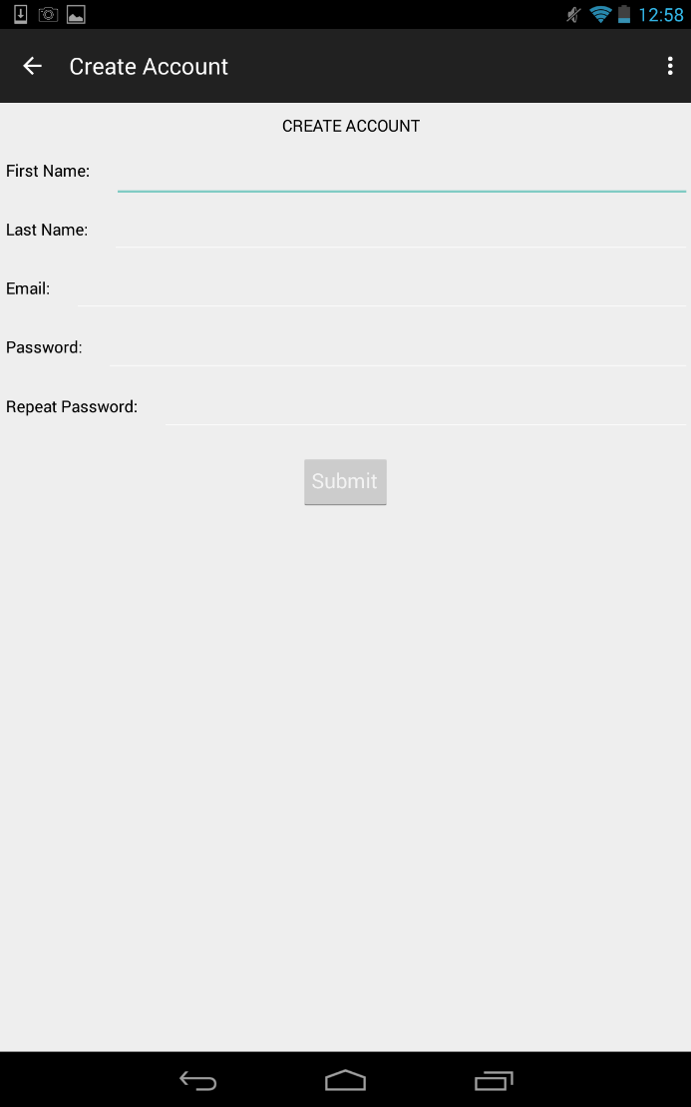
Step 2
The user previously need to make a click in CREATE ACCOUNT button and then he/she required to enter his/her personal information such as: First Name, Last Name, Email, Password and Repeat Password and then Submit the information.

Slide 5
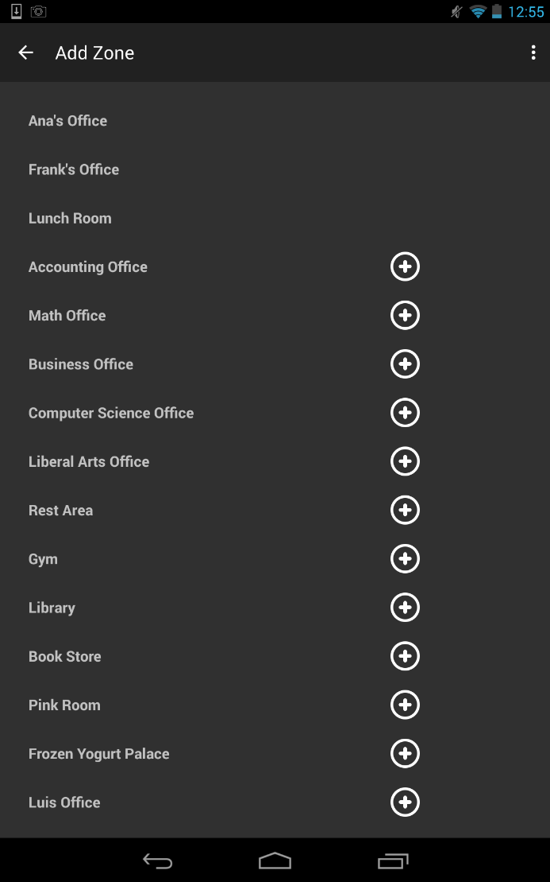
Step 3
The user can ADD A ZONE to his/her Account.

Slide 6
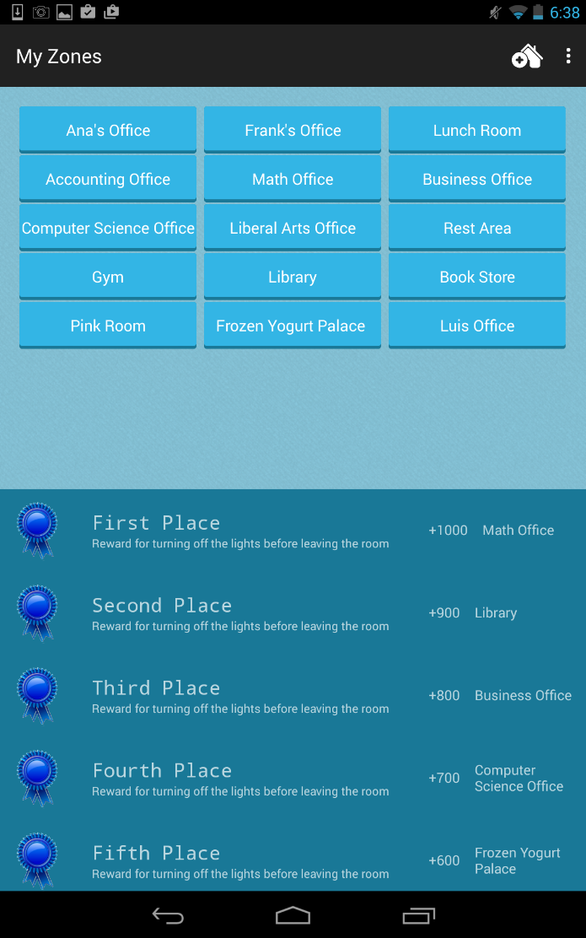
Step 4
The user is required to SELECT A ZONE where he/she can see the different options for energy performance.
The user can see REWARDS for turning off the lights before leaving the room and also for little consumption of energy in plug load.

Slide 7
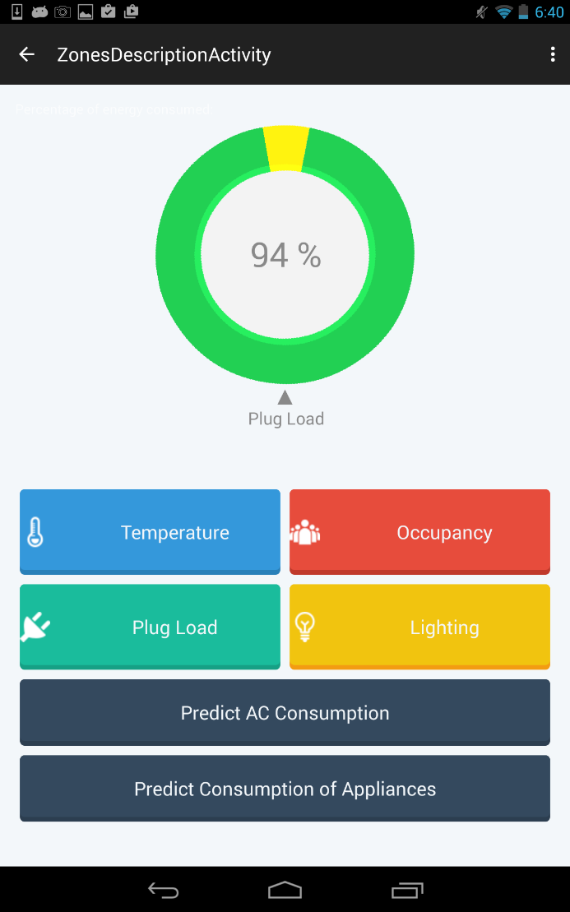
Step 5
General graphic information of Plug Load and Lighting
The user is required to make a selection in ZONES DESCRIPTION to see Temperature, Occupancy, Plug Load, Lighting, Predict Air Conditioning and/or Predict Consumption of Appliances.

Slide 8
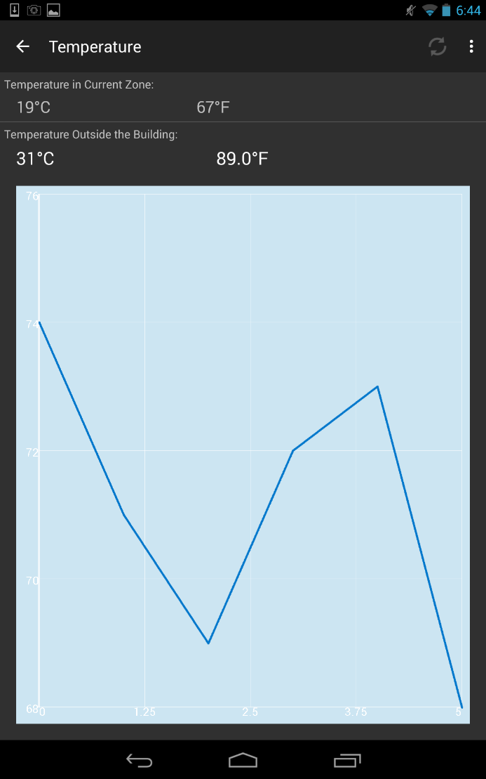
Step 6
The user can see the TEMPERATURE of one specific zone that had a previous selection and he/she is enable to make REFRESH in order to be able to always update the information. Also has its graphic representation.

Slide 9
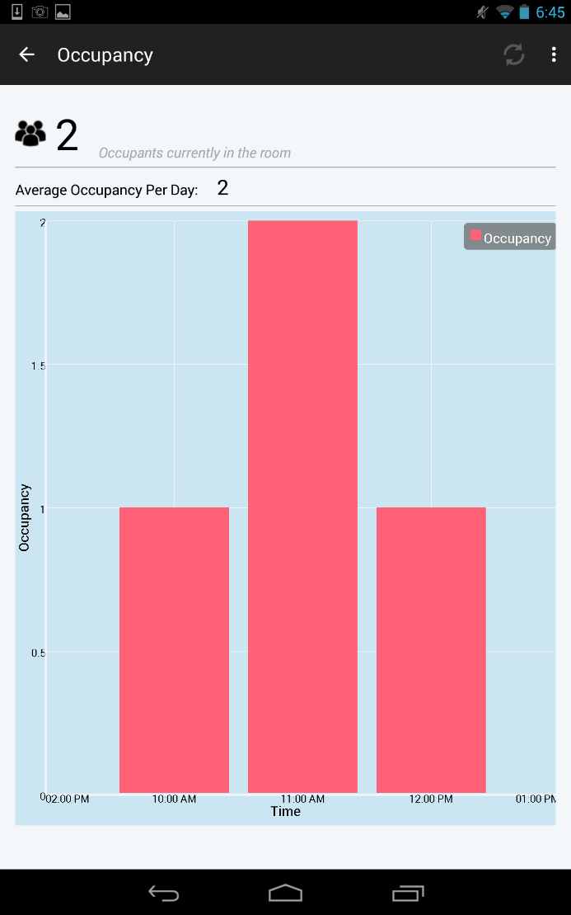
Step 7
The user can see the OCCUPANCY of one specific zone that had a previous selection and he/she is enable to make REFRESH in order to have always update it is information. Also has its graphic representation.

Slide 10
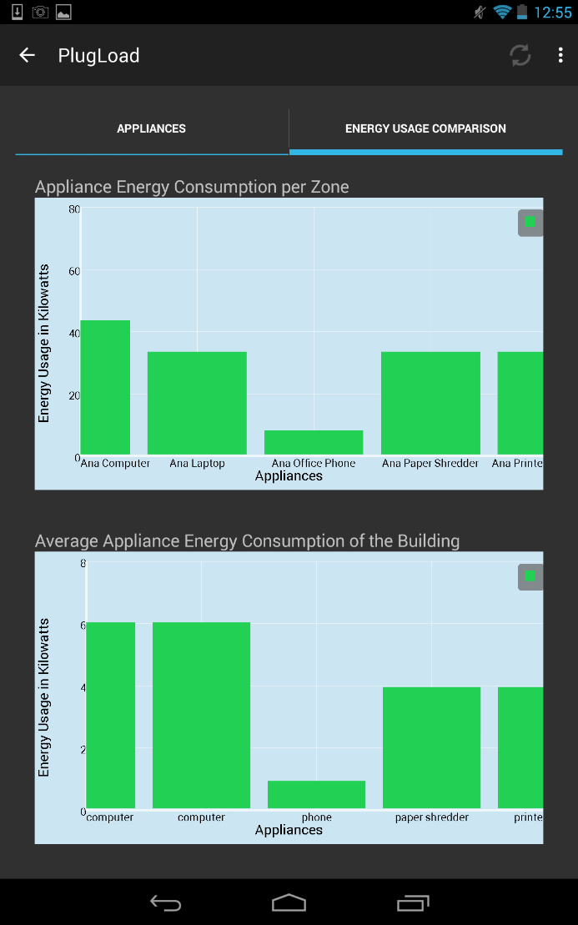
Step 8
The user can see the PLUG LOAD of one specific zone that had a previous selection and he/she is enable to make REFRESH in order to be able to always update the information. Also has its graphic representation for the appliance energy consumption per zone and its average for the building.

Slide 11
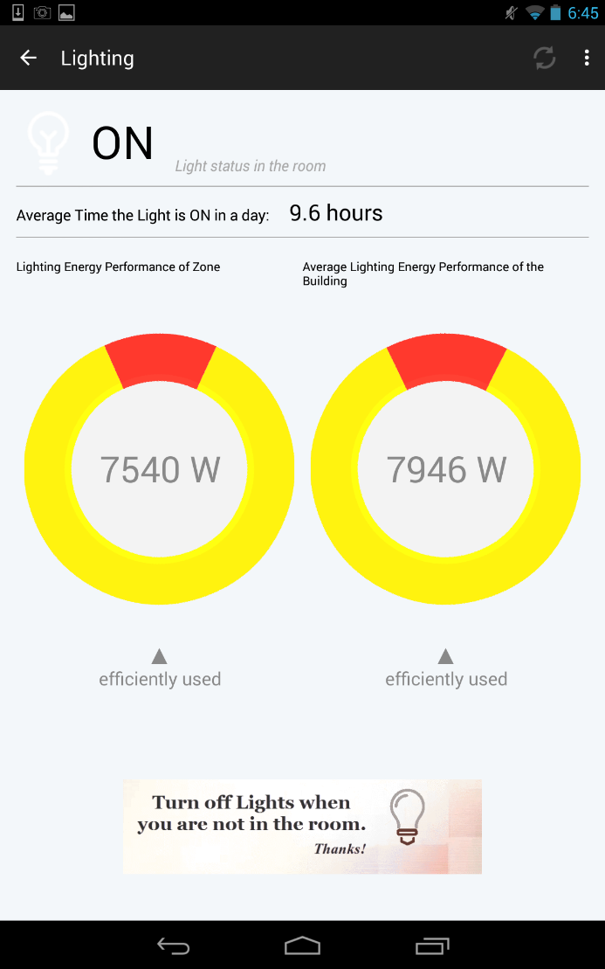
Step 9
The user can see the LIGHTING of one specific zone that had a previous selection and he/she is enable to make REFRESH in order to be able to always update the information. Also has its graphic representation or the energy performance and its average.

Slide 12
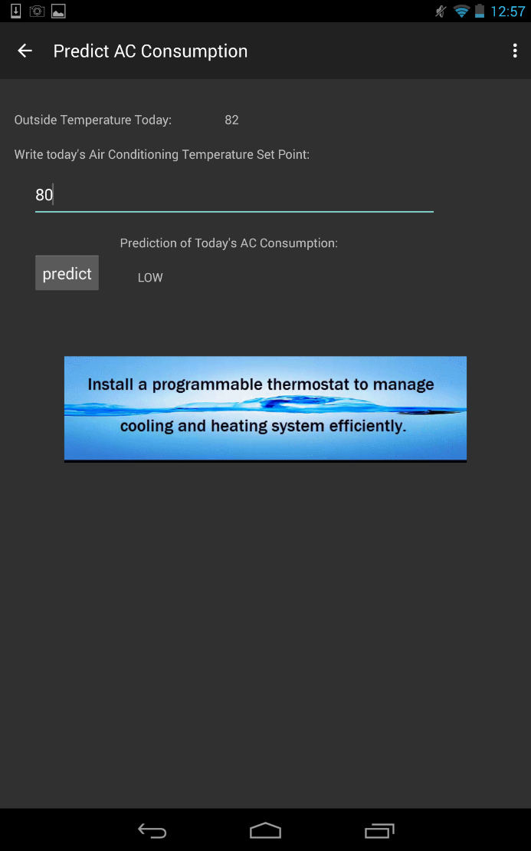
Step 10
The user can make A PREDICTION OF AIR CONDITIONING only entering his/her temperature Set Point and make a click in the button predict.
The user can see different ANIMATION GIFS in order to learn how to save energy in a simple way.

Slide 13
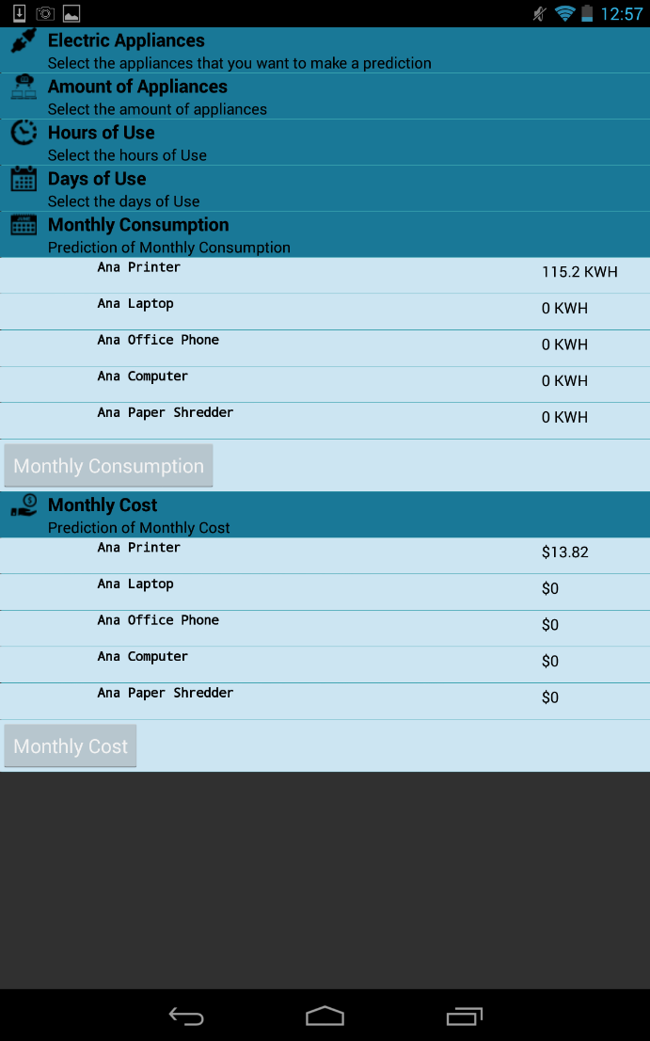
Step 11
The user can make A PREDICTION OF CONSUMPTION OF APPLIANCES only completing all the information in the expandable list and then make a click in the monthly consumption and monthly cost.

Slide 14
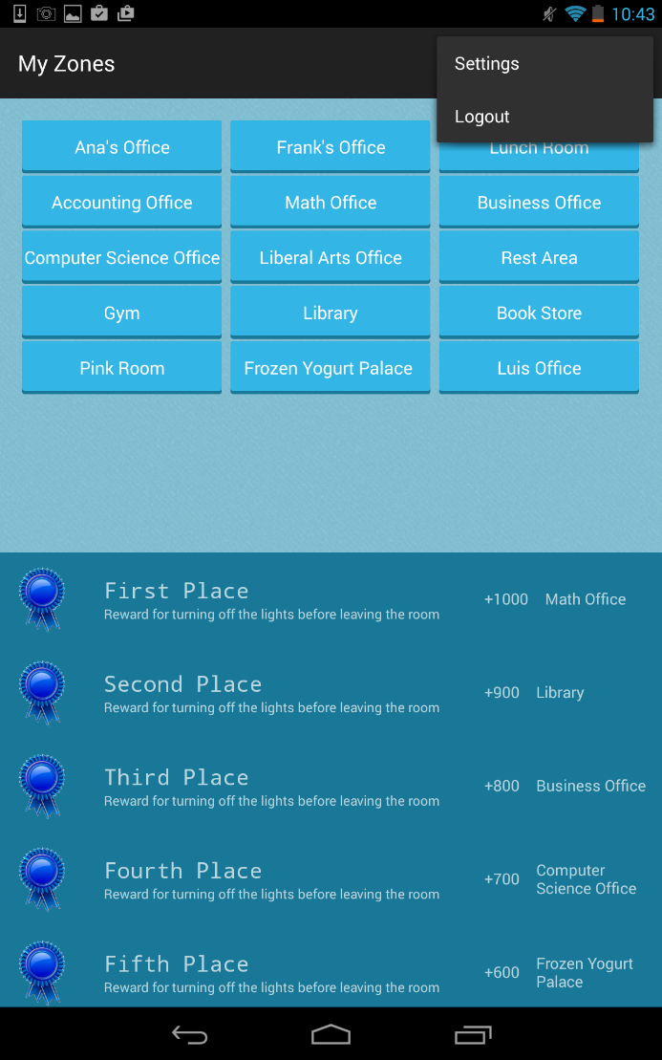
Step 12
The user is required open the popup menu in the Action Bar in order to click in the LOGOUT button

